Slide 1
Equipment for lining up food bags
Mentor: PhD. Dang Phuoc Vinh
Reserch student: Tran Truong Minh Chanh
Le Viet Hung

Slide 2
Table of contents
01
04
Introduction
Mechanical
Concerning the demands and goals of the subject topic.
Concerning the mechanical parts of our idea
02
05
Our idea
Control
Our solutions to the requirements.
Concerning the mechanical parts of our idea
03
Simulation
Concerning the demands and goals of the subject topic

Slide 3
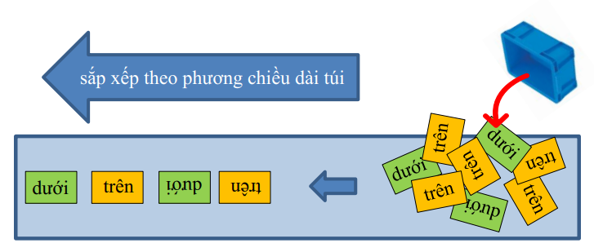
Introduction
01
Requirement
Positioned following container emptying.
Setting bags in a row according to bag length.
Applicable for two sorts of items.
Must be capable of separating overlapping bags.
Sort by bag length
Bottom
Top
Top
Bottom
Bottom
Top
Bottom
Top
Bottom
Bottom
Top
Bottom

Slide 4
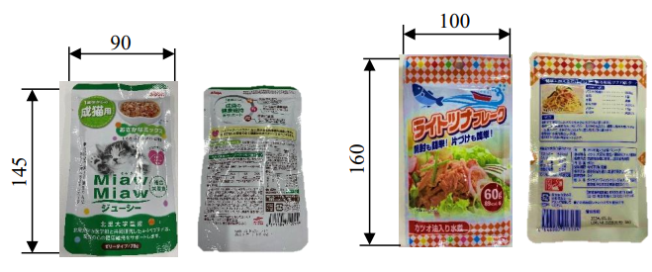
01
Introduction
Goals
- 120 bags/minute (10 seconds each carton) or higher.

Slide 5
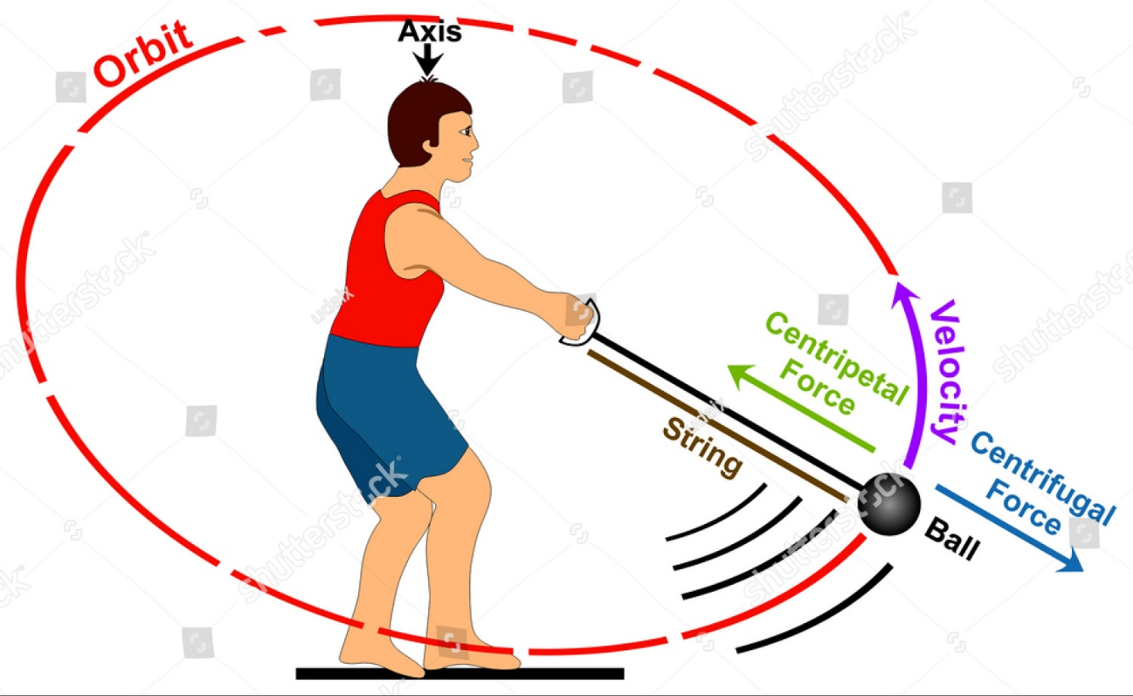
02
Our ideas
Use the centrifugal force principle & barriers as inspiration

Slide 6
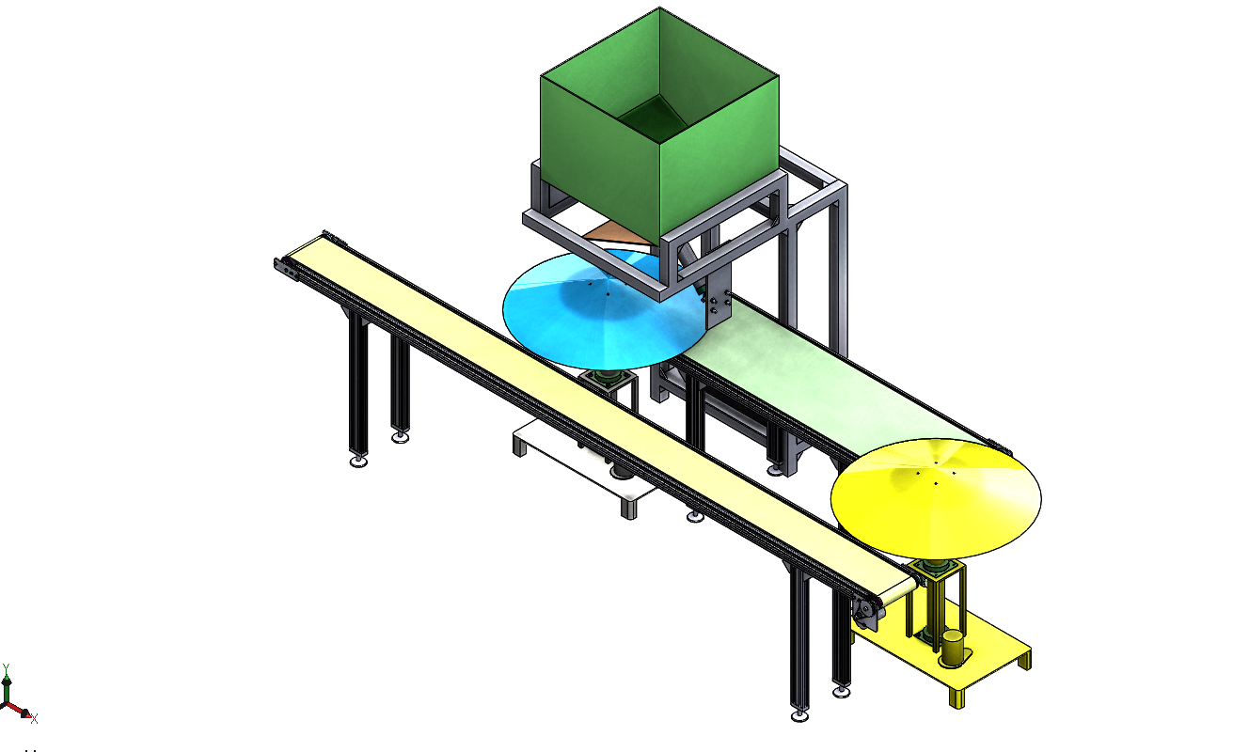
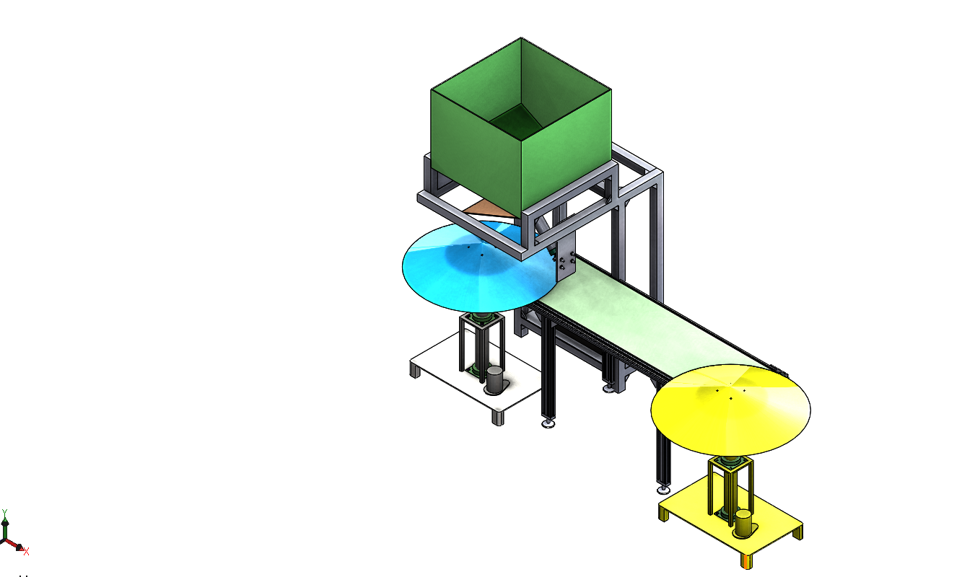
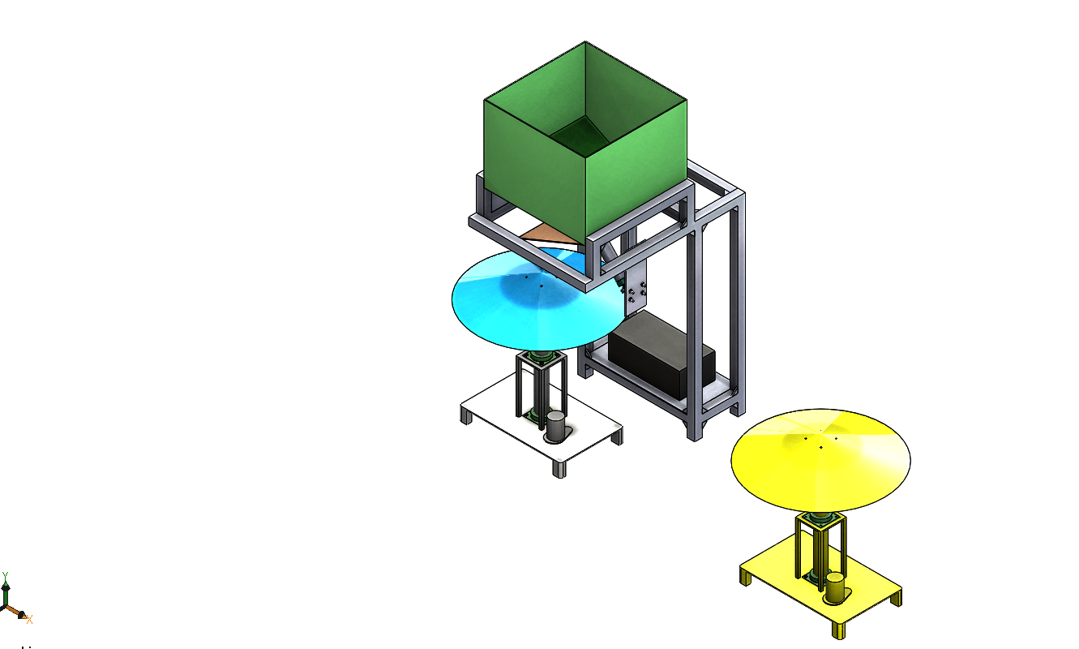
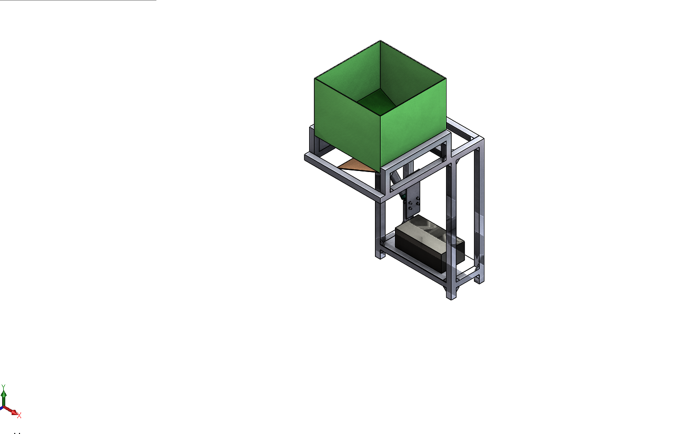
02
Our ideas
Cargo container
Cone 1
Conveyer 1
Cone 2
Conveyer 2

Slide 7
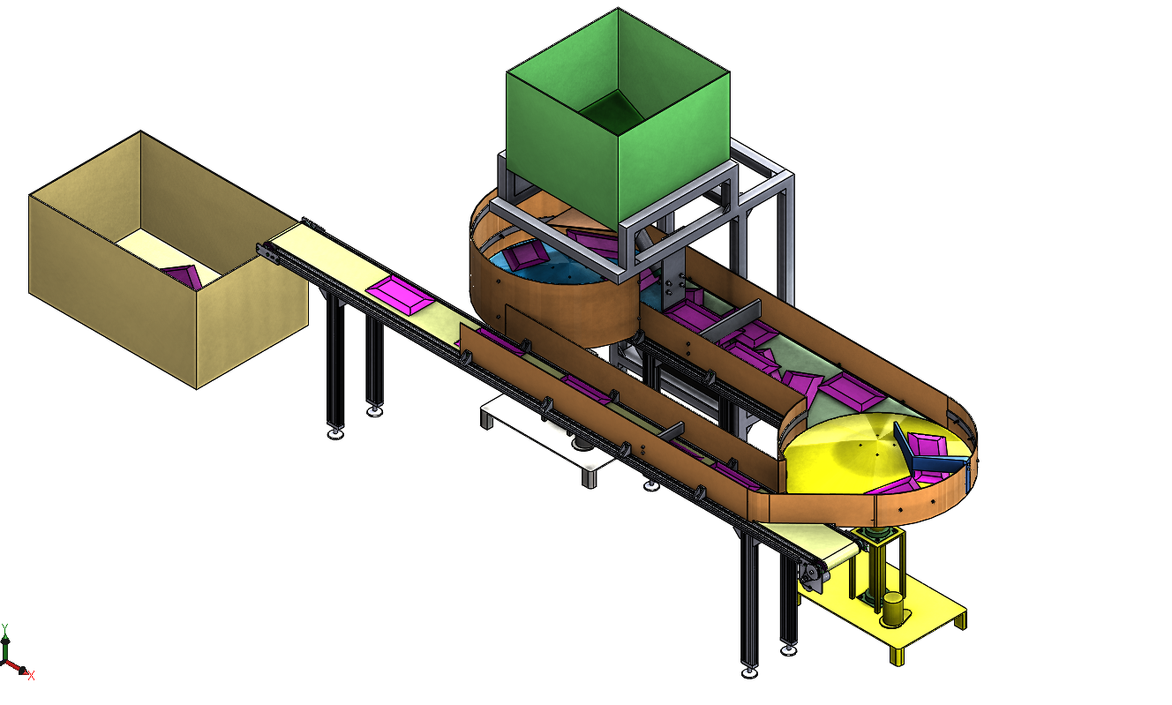
02
Our ideas
Conveyer’s acceleration > 0.3 m/s
Cargo container
Cone 1
Barrier 1
Conveyer 1
Cone 2
Barrier 2
Conveyer 2
Barrier 3
2.0 x 0.9 x 1.5(m) - L x W x H

Slide 8
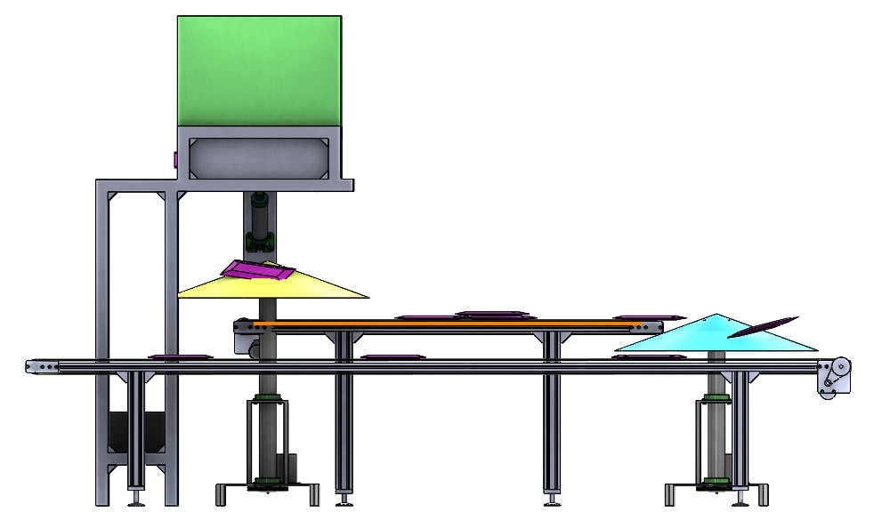
02
Our ideas
Conveyer’s acceleration > 0.3 m/s
Cone 1
Conveyer 1
10 cm
Cone 2
10 cm
Conveyer 2

Slide 9
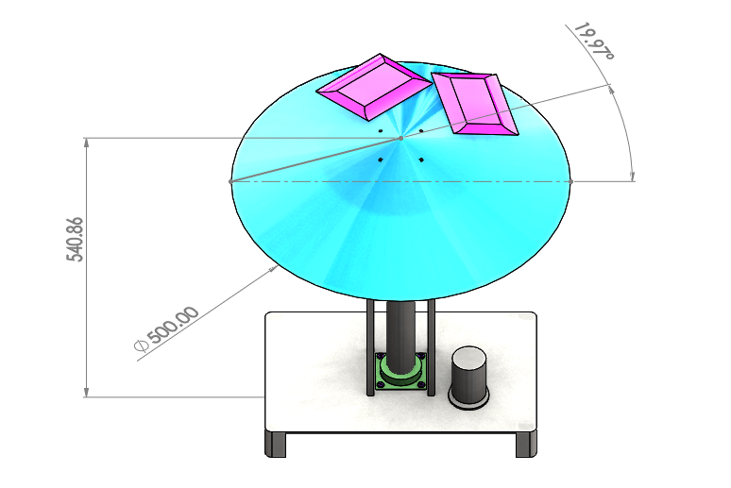





02
Our ideas
15°
540
Cone

Slide 10
Thank you !

